Slide 1
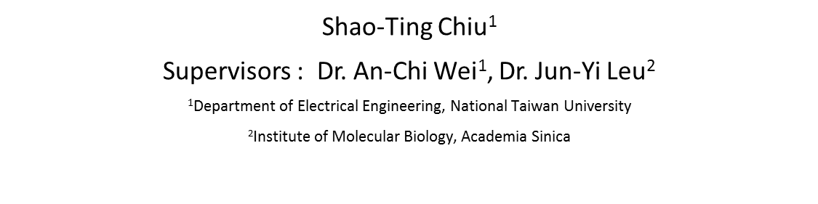
Information Transduction Capacity of Mitochondrial Retrograde Signaling
Shao-Ting Chiu¹
Supervisors : Dr. An-Chi Wei¹, Dr. Jun-Yi Leu²
$\text{1}$Department of Electrical Engineering, National Taiwan University
²Institute of Molecular Biology, Academia Sinica
Keyword: retrograde response, mitochondrial membrane potential ($∆ψm$),
information theory
2017/03/08

Slide 2
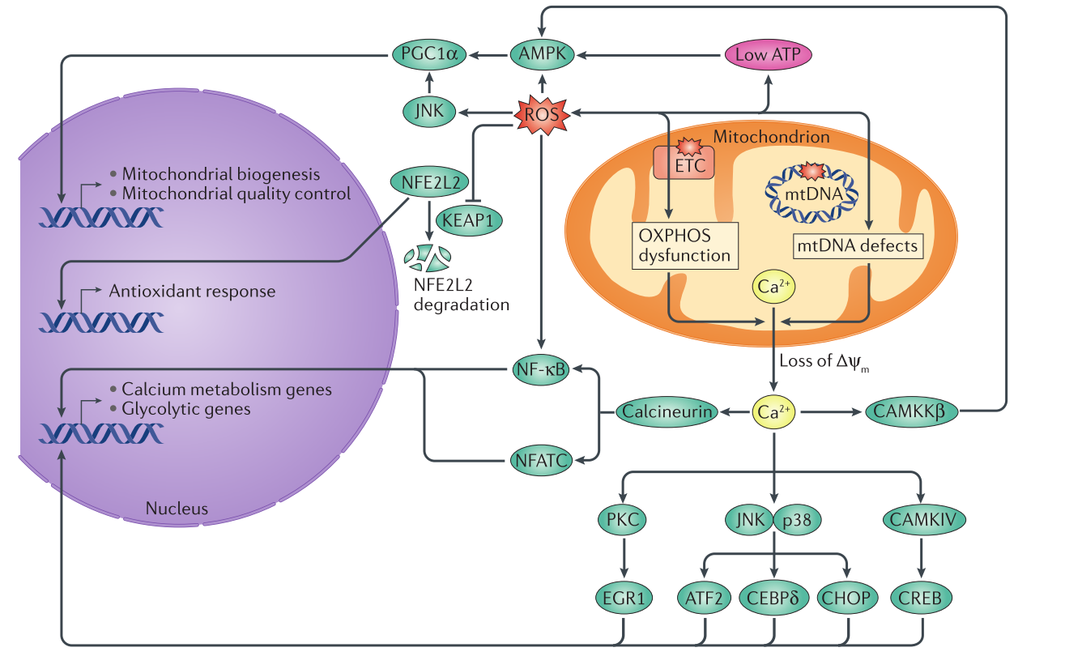
The Communication Between Mitochondria and Nucleus
Pedro M. Quirós et al., 2016

Slide 3
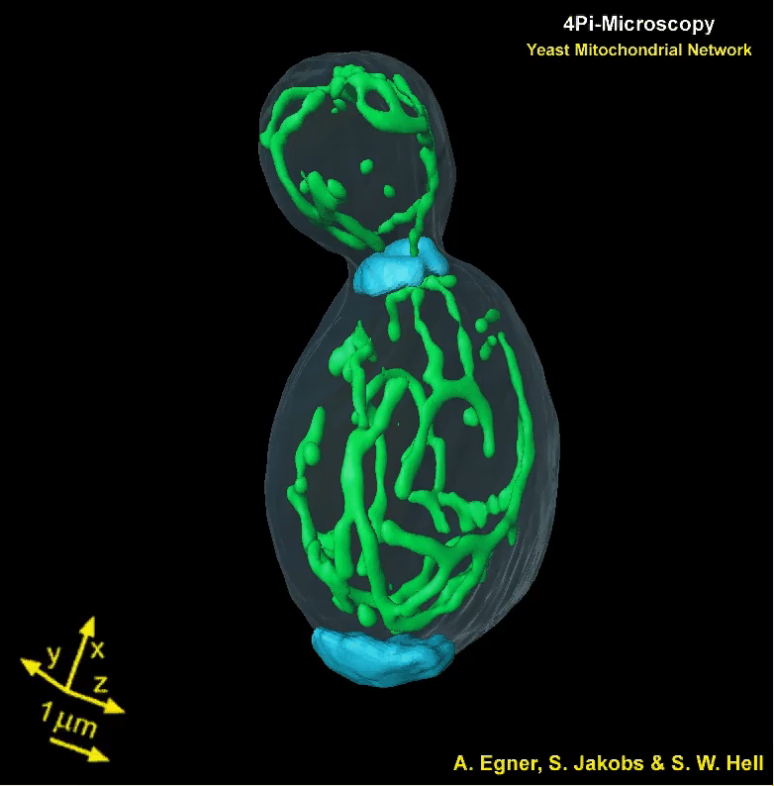
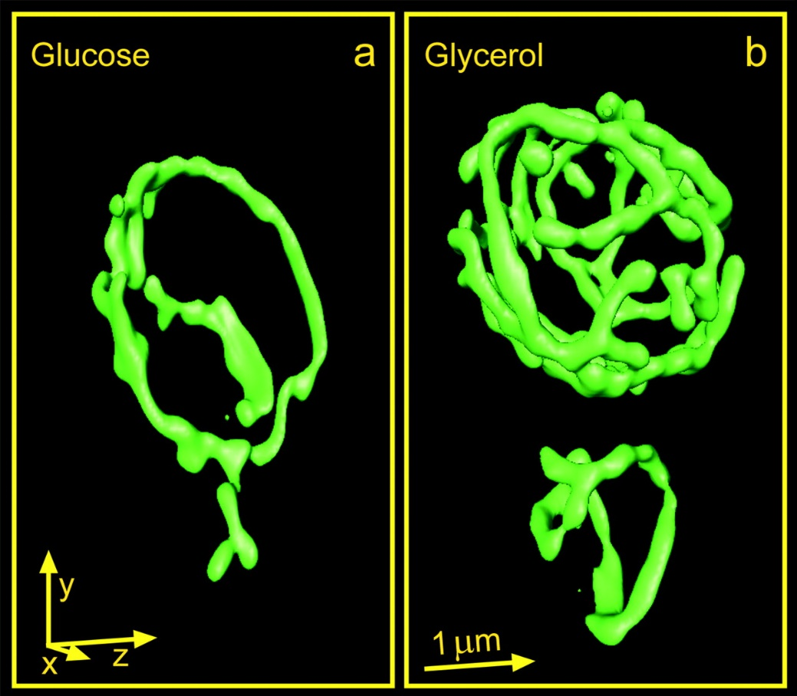
Yeast Mitochondrial Nwtwork
GFP-labeled mitochondrial compartment of live S. cerevisiae. Images were taken by fast 100-nm resolution three-dimensional microscope. (A. Egner et al., 2002)
A. Egner et al., 2002

Slide 4
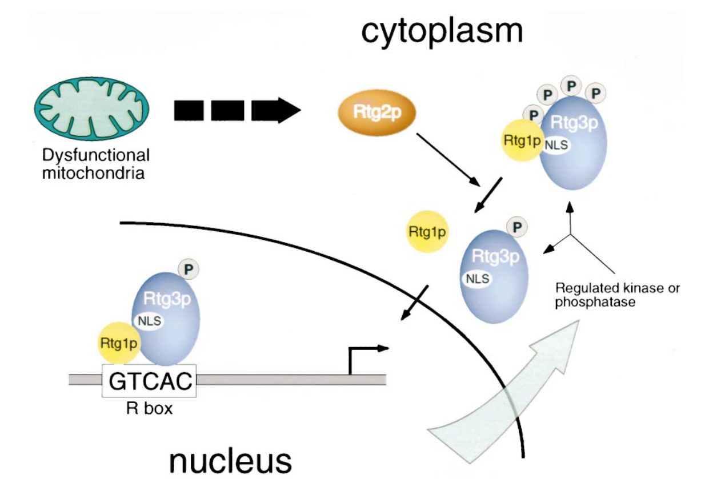
Properties of Retrograde Signaling – a binary prospect
Model of the control of mitochondria-to-nuclear signaling. (Takayuki Sekito et al., 2000)
Takayuki Sekito et al., 2000

Slide 5
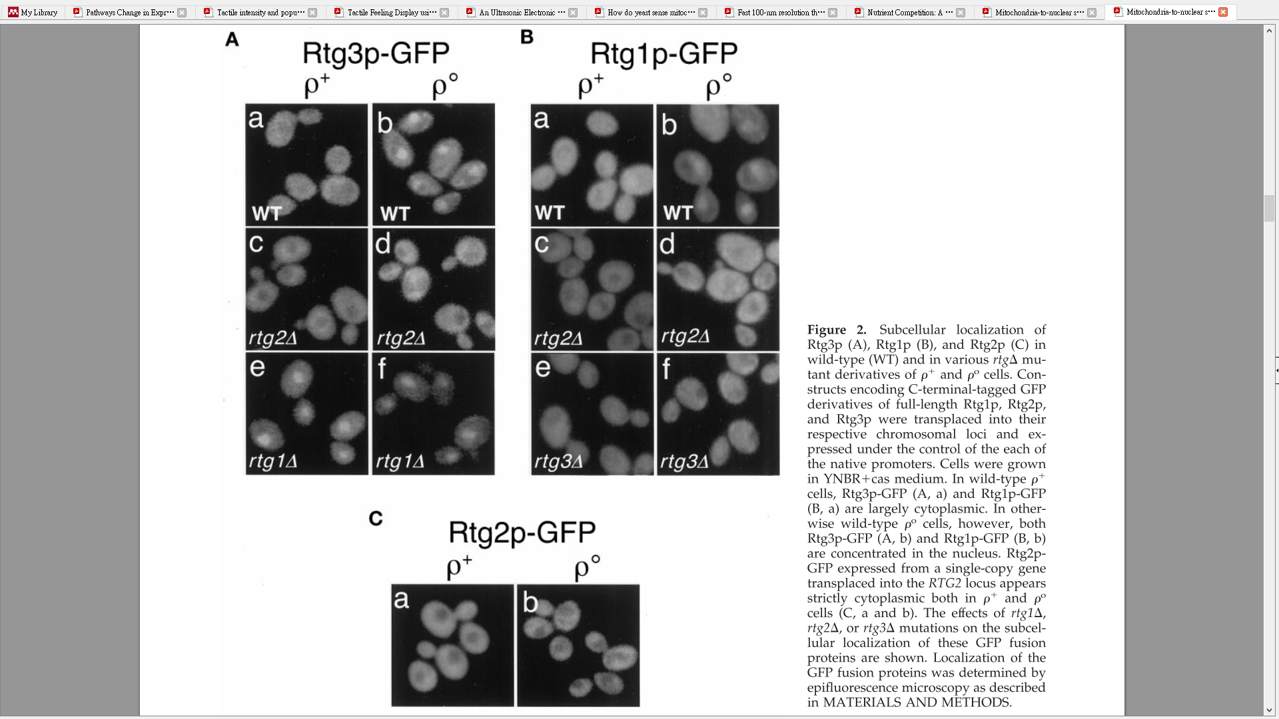
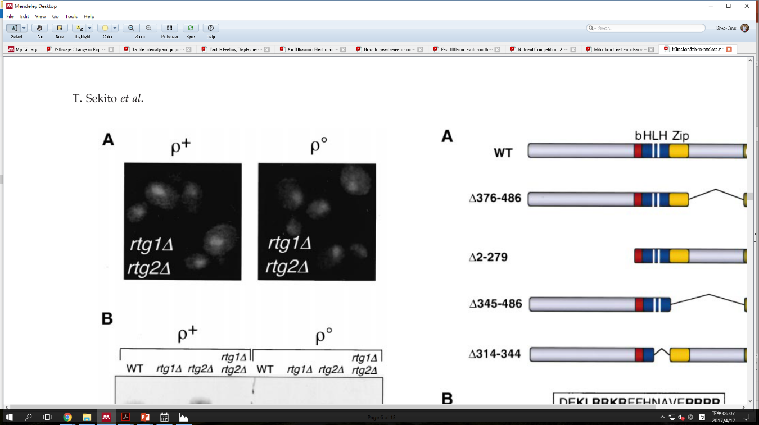
Properties of Retrograde Signaling – a binary prospect
Rtg3p-GFP
Rtg1p-GFP
ρ⁺
ρ⁰
ρ⁺
ρ⁰
WT
WT
rtg2Δ
rtg2Δ
rtg1Δ
rtg3Δ
rtg1Δ
rtg2Δ
Rtg2p-GFP
Rtg3p-GFP
ρ⁺
ρ⁰
rtg2Δ
Subcellular localization of Rtg1p, Rtg2p and Rtg3p (Takayuki Sekito et al., 2000)
*ρ⁺: Wild type; ρ⁰: Deletion of mitochondrial genome
Takayuki Sekito et al., 2000

Slide 6
Properties of Retrograde Signaling based on binary experiments
Rtg2p is always cytoplasmic.
The expression of RTG regulated genes require translocation of both Rtg1p and Rtg3p
Rtg1p inhibit the translocation of Rtg3p; Rtg1p regulates the pathway both positively and negatively.
The nucleus accumulation of Rtg3p-Rtg1p heterodimer requires Rtg2p.
Model of the control of mitochondria-to-nuclear signaling. (Takayuki Sekito et al., 2000)
Takayuki Sekito et al., 2000

Slide 7
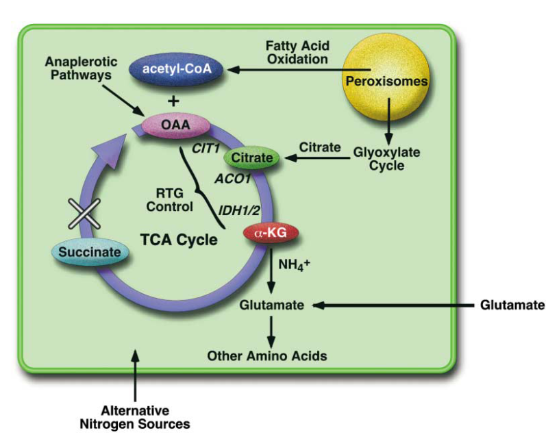
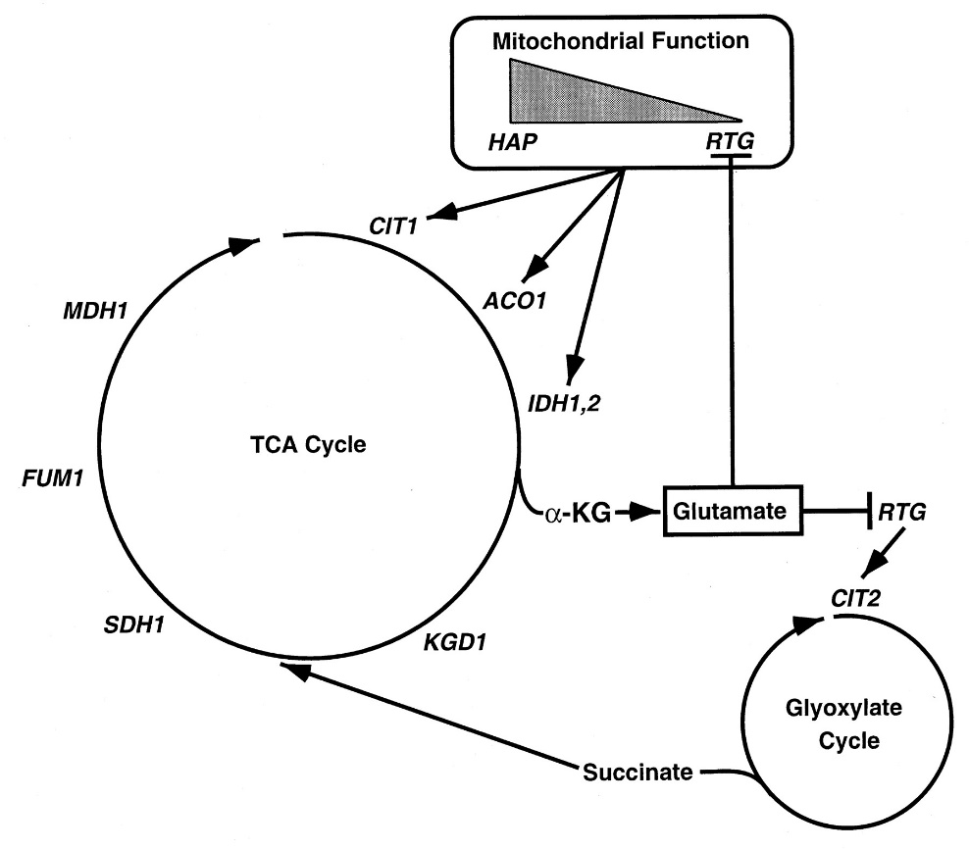
Which genes are regulated by Retrograde Response in Yeast?
*CIT2 is also regulated by RTG pathway
The retrograde pathway enables respiratory-deficient cells to maintain glutamate supplies by providing substrates for α-ketoglutarate (ETC inhibited)
Figures from Ronald A. Butow and Narayan G. Avadhani, 2004 (left) and Zhengchang Liu, and Ronald A. Butow, 1999 (right)

Slide 8
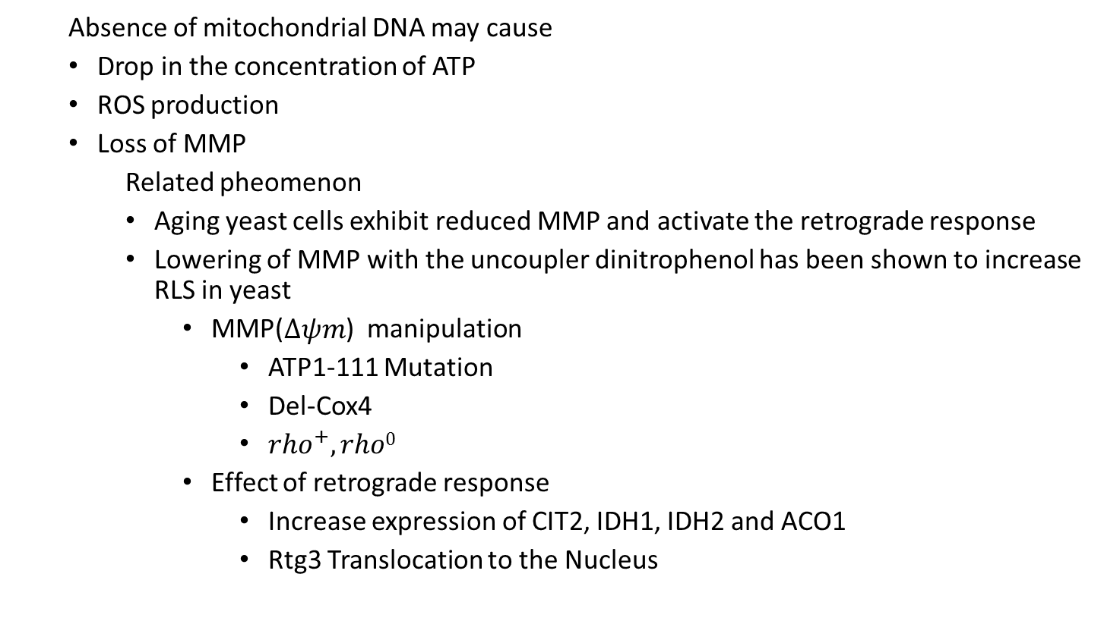
Possible mitochondrial signals that can trigger retrograde response
Absence of mitochondrial DNA may cause
Drop in the concentration of ATP
ROS production
Loss of MMP
Related pheomenon
Aging yeast cells exhibit reduced MMP and activate the retrograde response
Lowering of MMP with the uncoupler dinitrophenol has been shown to increase RLS in yeast
MMP($∆ψm$) manipulation
ATP1-111 Mutation
Del-Cox4
${rho}^{+},rho0$
Effect of retrograde response
Increase expression of CIT2, IDH1, IDH2 and ACO1
Rtg3 Translocation to the Nucleus

Slide 9
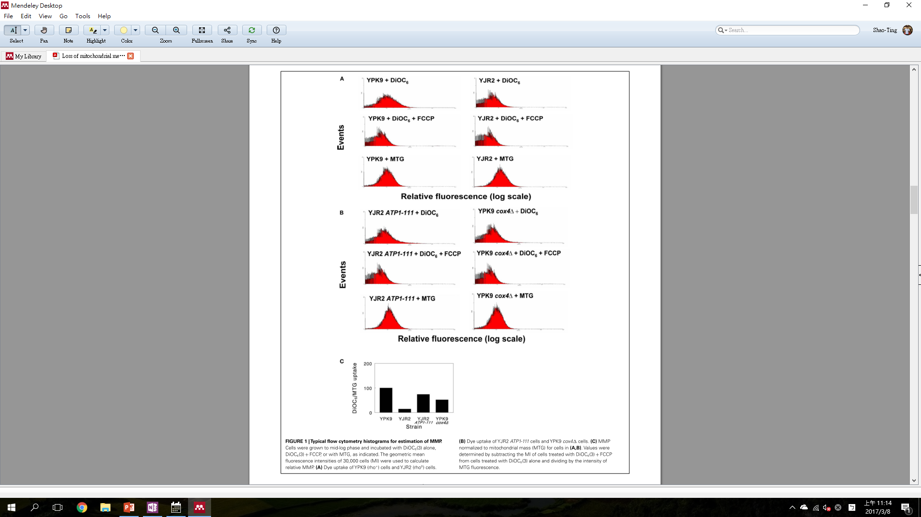
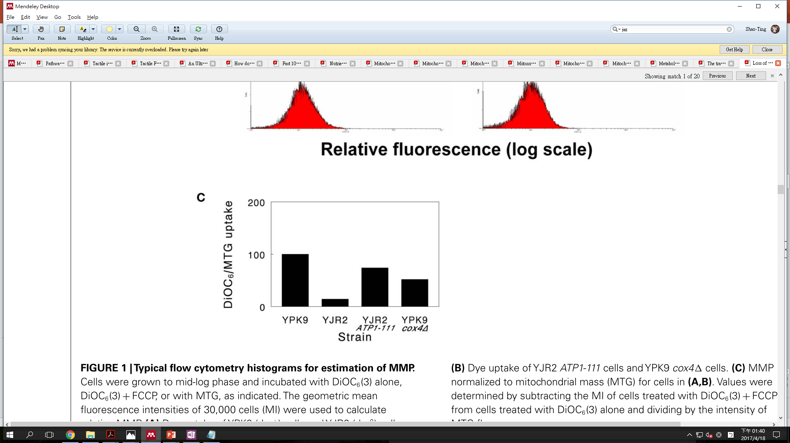
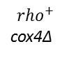
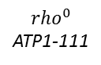
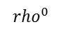
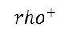
Properties of Retrograde Signaling – a tertiary prospect
$${rho}^{0}$$
ATP1-111
$${rho}^{+}$$
cox4Δ
$${rho}^{+}$$
$${rho}^{0}$$
Genetic manipulation of mitochondrial membrane potential. (M. V. Miceli et al., 2012)
Measuring mitochondrial membrane potential by flow cytometry. (M. V. Miceli et al., 2012)
M. V. Miceli et al., 2012

Slide 10
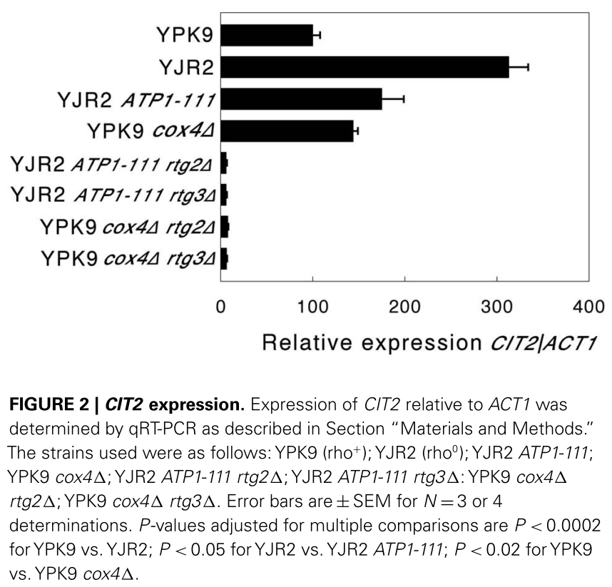
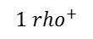
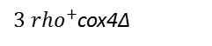
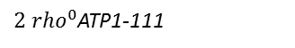
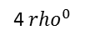
Properties of Retrograde Signaling – a tertiary prospect
An increase in CIT2 expression is considred diagnostic for the activation of the retrogade response.
$$1 {rho}^{+}$$
4 ${rho}^{0}$
${2 rho}^{0}$ATP1-111
${3 rho}^{+}$cox4Δ
M. V. Miceli et al.,2012

Slide 11
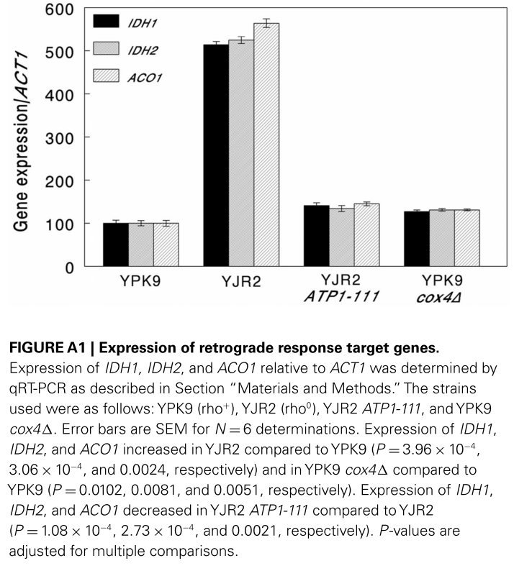
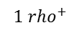

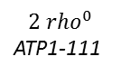
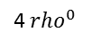
MMP May be the trigger of Mitochondrial Retrograde Response
IDH1, IDH2 and ACO1 are also considred diagnostic for the activation of the retrogade response
$$1 {rho}^{+}$$
4 ${rho}^{0}$
$${2 rho}^{0}$$
ATP1-111
$${3 rho}^{+}$$
cox4Δ
M.V.Miceli et al.

Slide 12
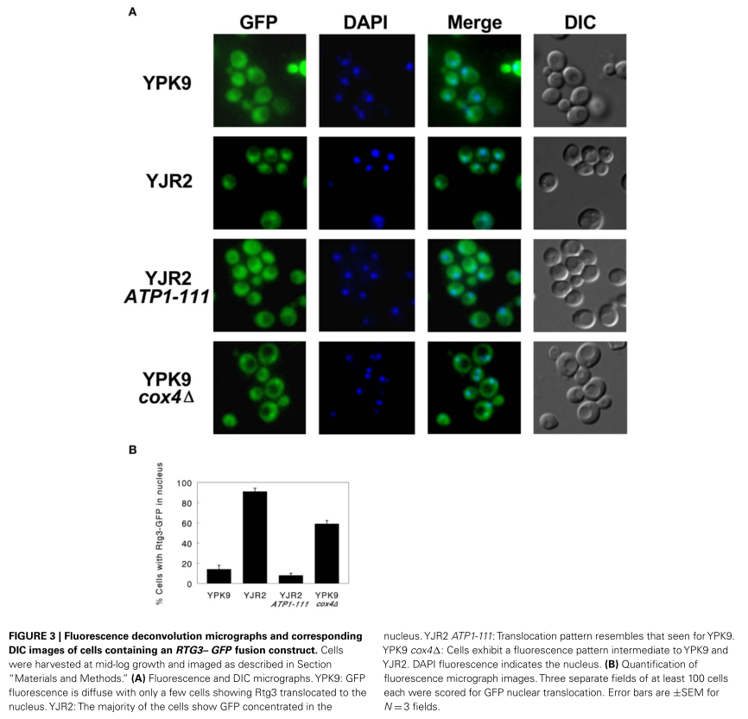
MMP May be the trigger of Mitochondrial Retrograde Response
RTG3-GFP translocation as a indicator of retrograde signaling
M.V.Miceli et al.

Slide 13
Functions of RTG-regulated Genes
TCA
ACO1 :Aconitate hydratase with role in tricarboxylic acid (TCA) cycle and mitochondrial genome maintenance; also shows DNA binding activity; localized to mitochondria and cytosol
IDH1/2: Subunit of mitochondrial NAD(+)-dependent isocitrate dehydrogenase; complex catalyzes the oxidation of isocitrate to alpha-ketoglutarate in the TCA cycle.
CIT1: Citrate synthase; catalyzes the condensation of acetyl coenzyme A and oxaloacetate to form citrate; the rate-limiting enzyme of the TCA cycle; nuclear encoded mitochondrial protein
Glyoxylate Cycle
CIT2: Citrate synthase, peroxisomal isozyme involved in glyoxylate cycle; catalyzes condensation of acetyl coenzyme A and oxaloacetate to form citrate; expression is controlled by Rtg1p and Rtg2p transcription factors; SCF-Ucc1 regulates level of Cit2p to maintain citrate homeostasis; oxaloacetate-dependent positive feedback loop inhibits Cit2p ubiquitination; CIT2 has a paralog
Saccharomyces Genome Database (http://www.yeastgenome.org/)

Slide 14
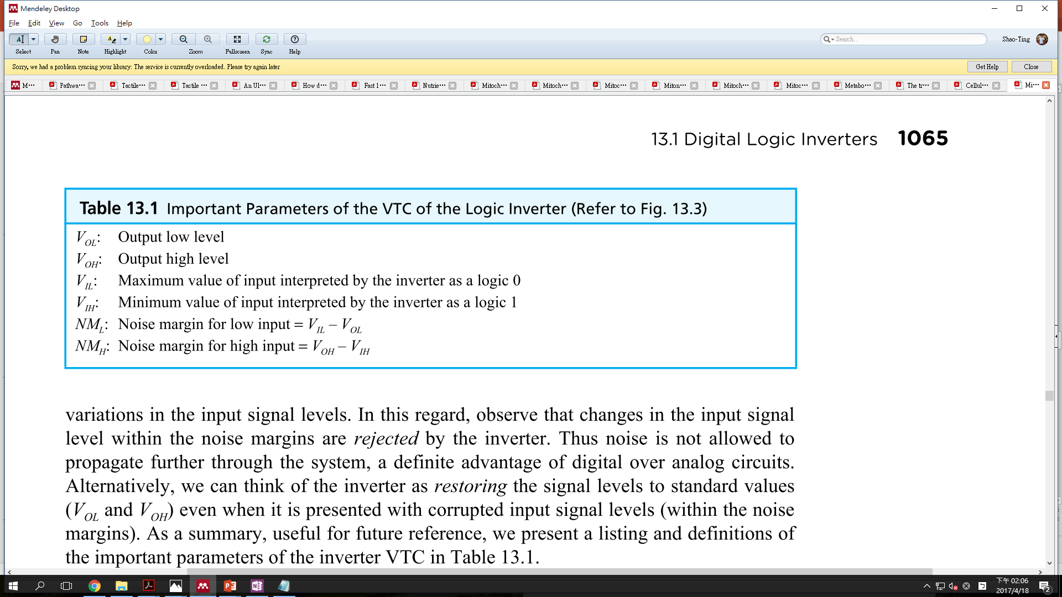
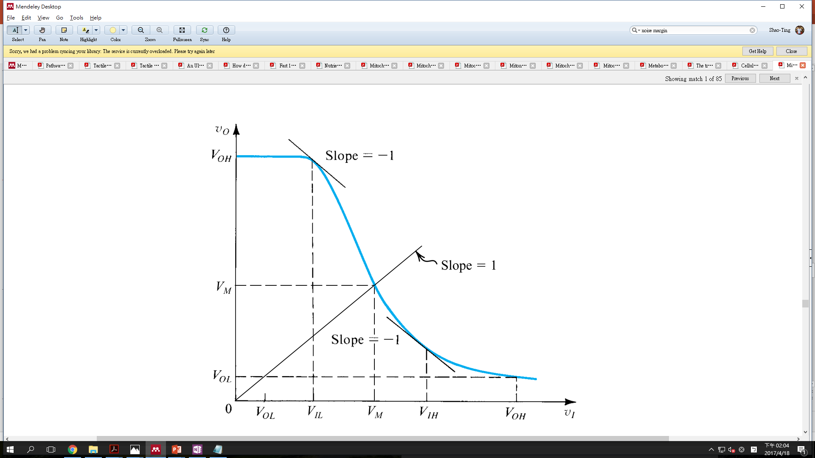

Slide 15
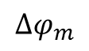
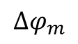
Retrograde response may be a inverter-like response
RTG response
$$∆φ_{m}$$
+
-
$$∆φ_{m}$$
Modified from S.A. &Smith, C.K., 2009. Microelectronic Circuits

Slide 16
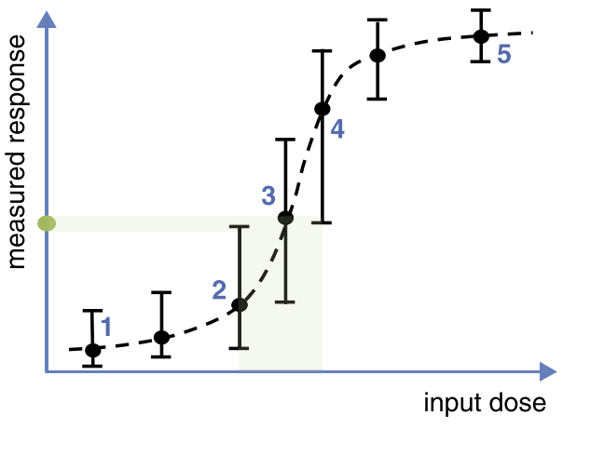
Biochemical Noise Limits the information-transmission rate

Slide 17
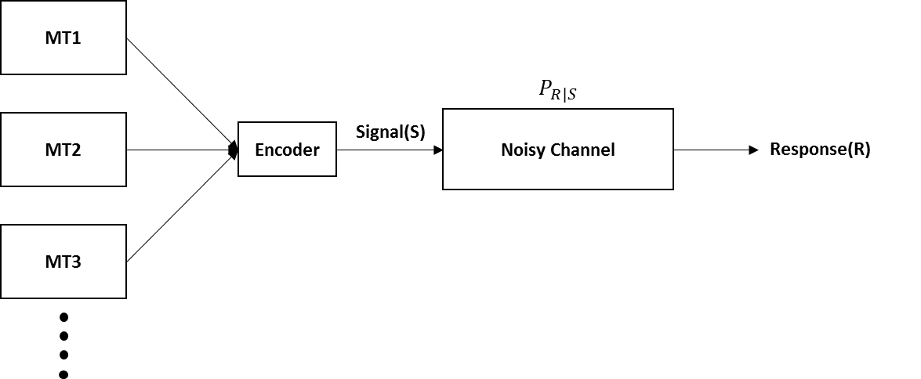
Biochemical Pathway of Retrograde Response
Z. Liu and R. A Butow

Slide 18
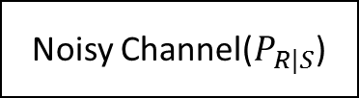
Problem Setup
What is the maximum number of MMP stimuli that a cell can distinguish based upon the noisy responses of RTG pathway?
CIT2
MMP
IDH1
MMP
Noisy Channel($P_{R|S}$)
IDH2
MMP
ACO1
MMP
Signal(S)
Response(R)

Slide 19
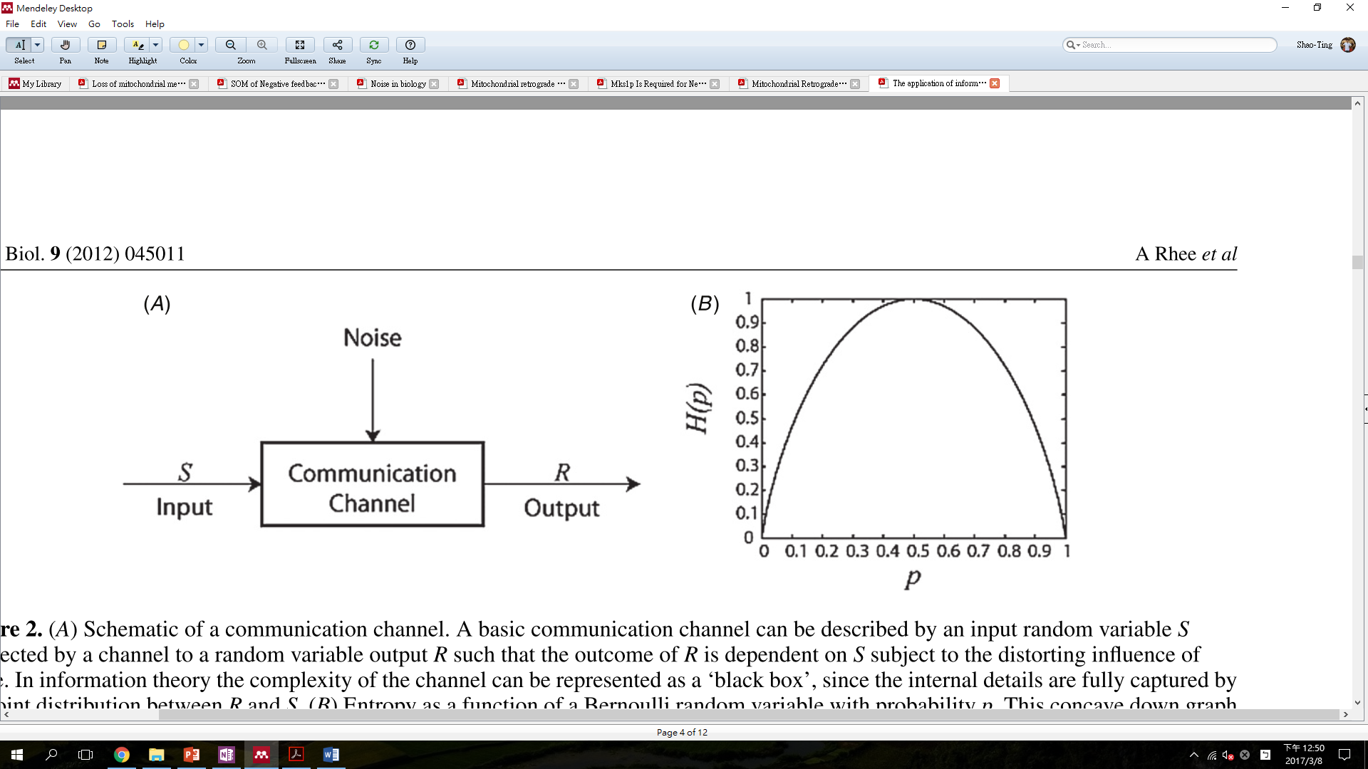
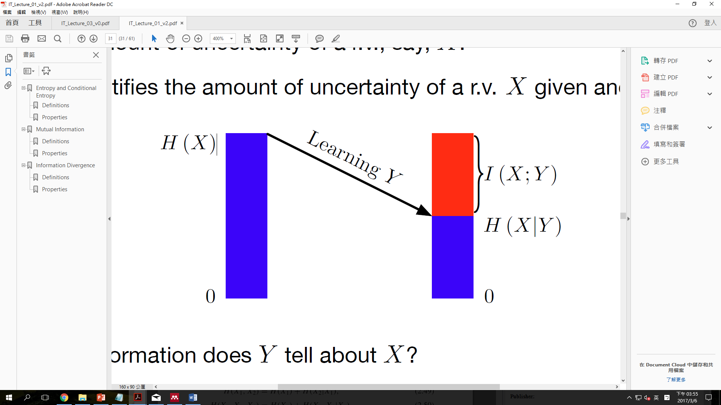
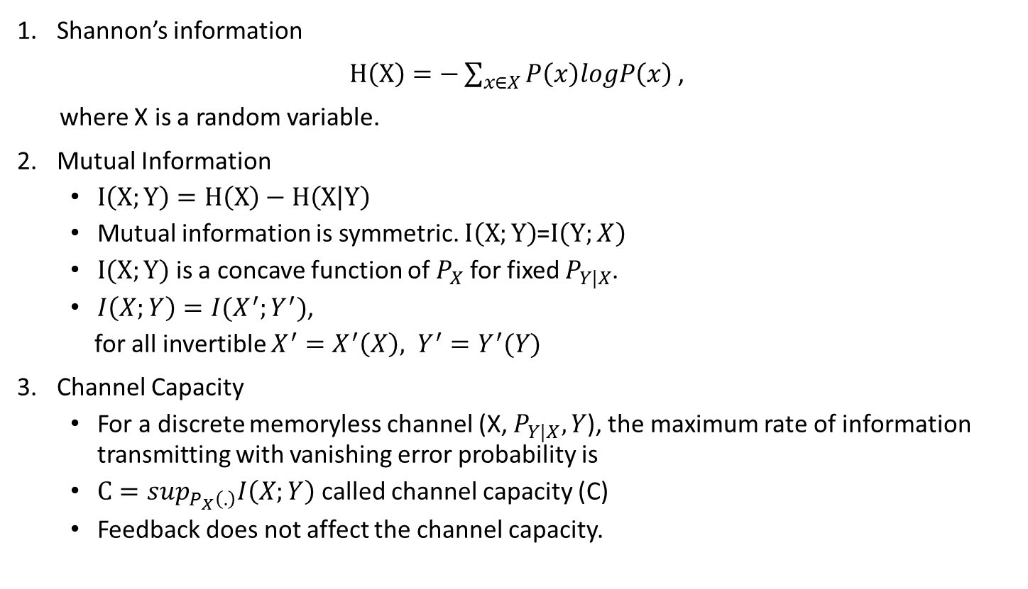
Key Points in Information Theory
Shannon’s information
$H\left(X\right)=−\sum_{x∈X}{P\left(x\right)logP\left(x\right)}$,
where X is a random variable.
Mutual Information
$I\left(X;Y\right)=H\left(X\right)−H\left(X | Y\right)$
Mutual information is symmetric. $I\left(X;Y\right)$=$I\left(Y;X\right)$
$I(X;Y)$ is a concave function of $P_{X}$ for fixed $P_{Y|X}$.
$I\left(X;Y\right)=I(X^{′};Y^{′})$,
for all invertible $X^{′}=X^{′}\left(X\right), Y^{′}=Y^{′}(Y)$
Channel Capacity
For a discrete memoryless channel (X, $P_{Y|X}, Y$), the maximum rate of information transmitting with vanishing error probability is
$C=\sup_{P_{X}\left(.\right)}I\left(X;Y\right)$called channel capacity (C)
Feedback does not affect the channel capacity.
Diagram of Mutual Information

Slide 20
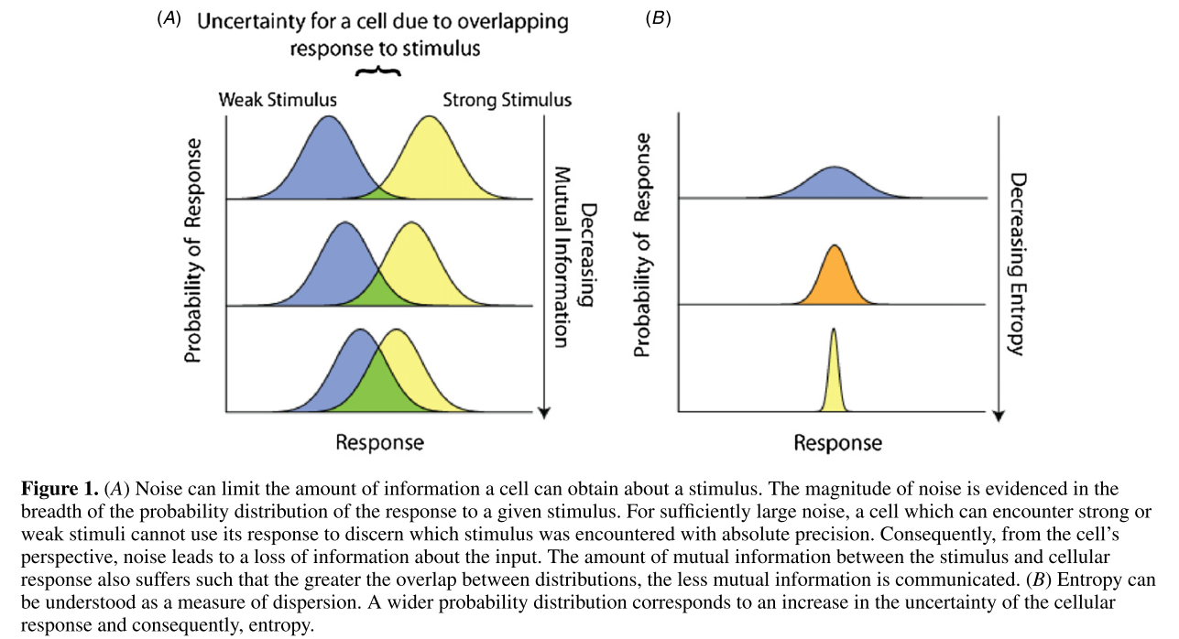
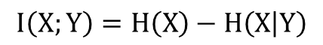
Response and Mutual Information
$$I\left(X;Y\right)=H\left(X\right)−H\left(X | Y\right)$$
R. Cheong et al.

Slide 21
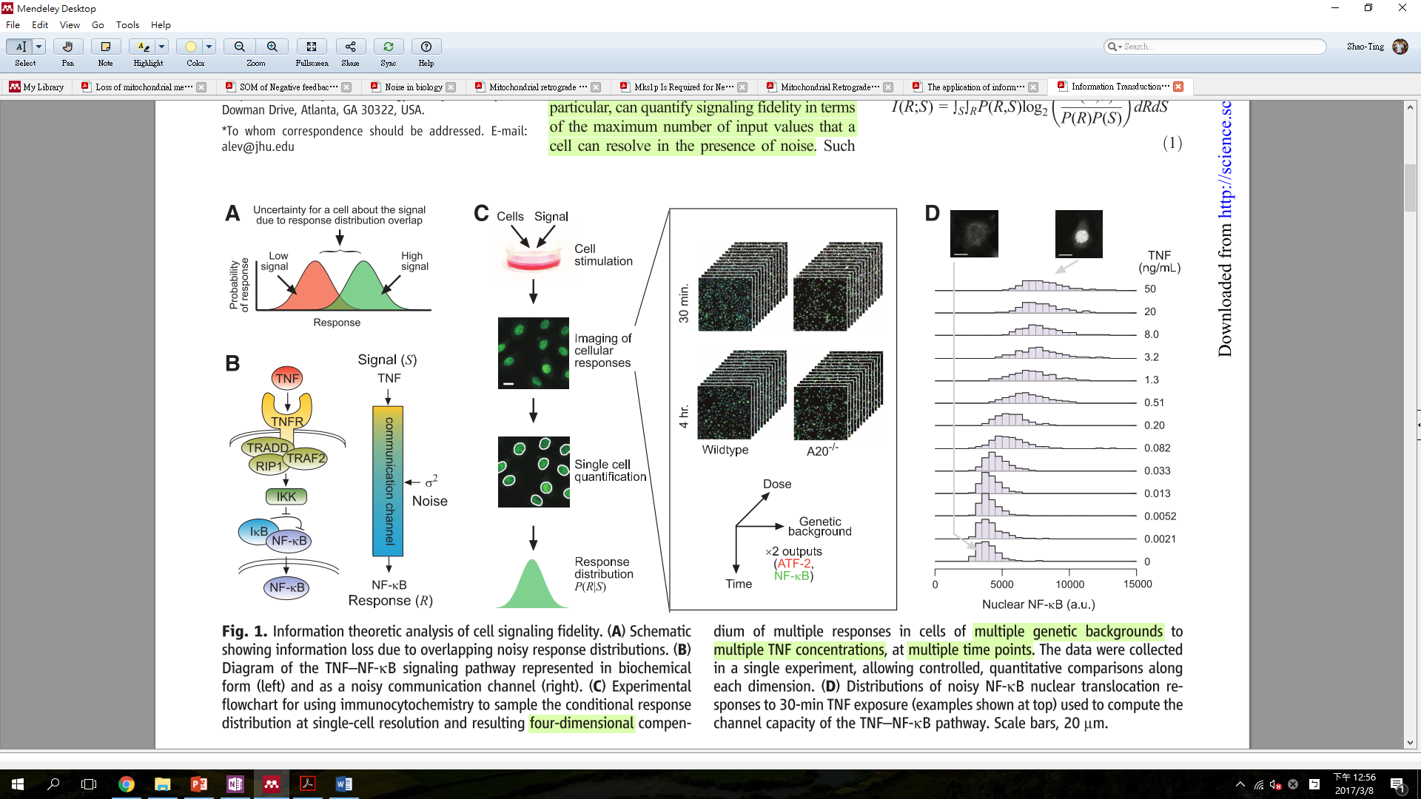
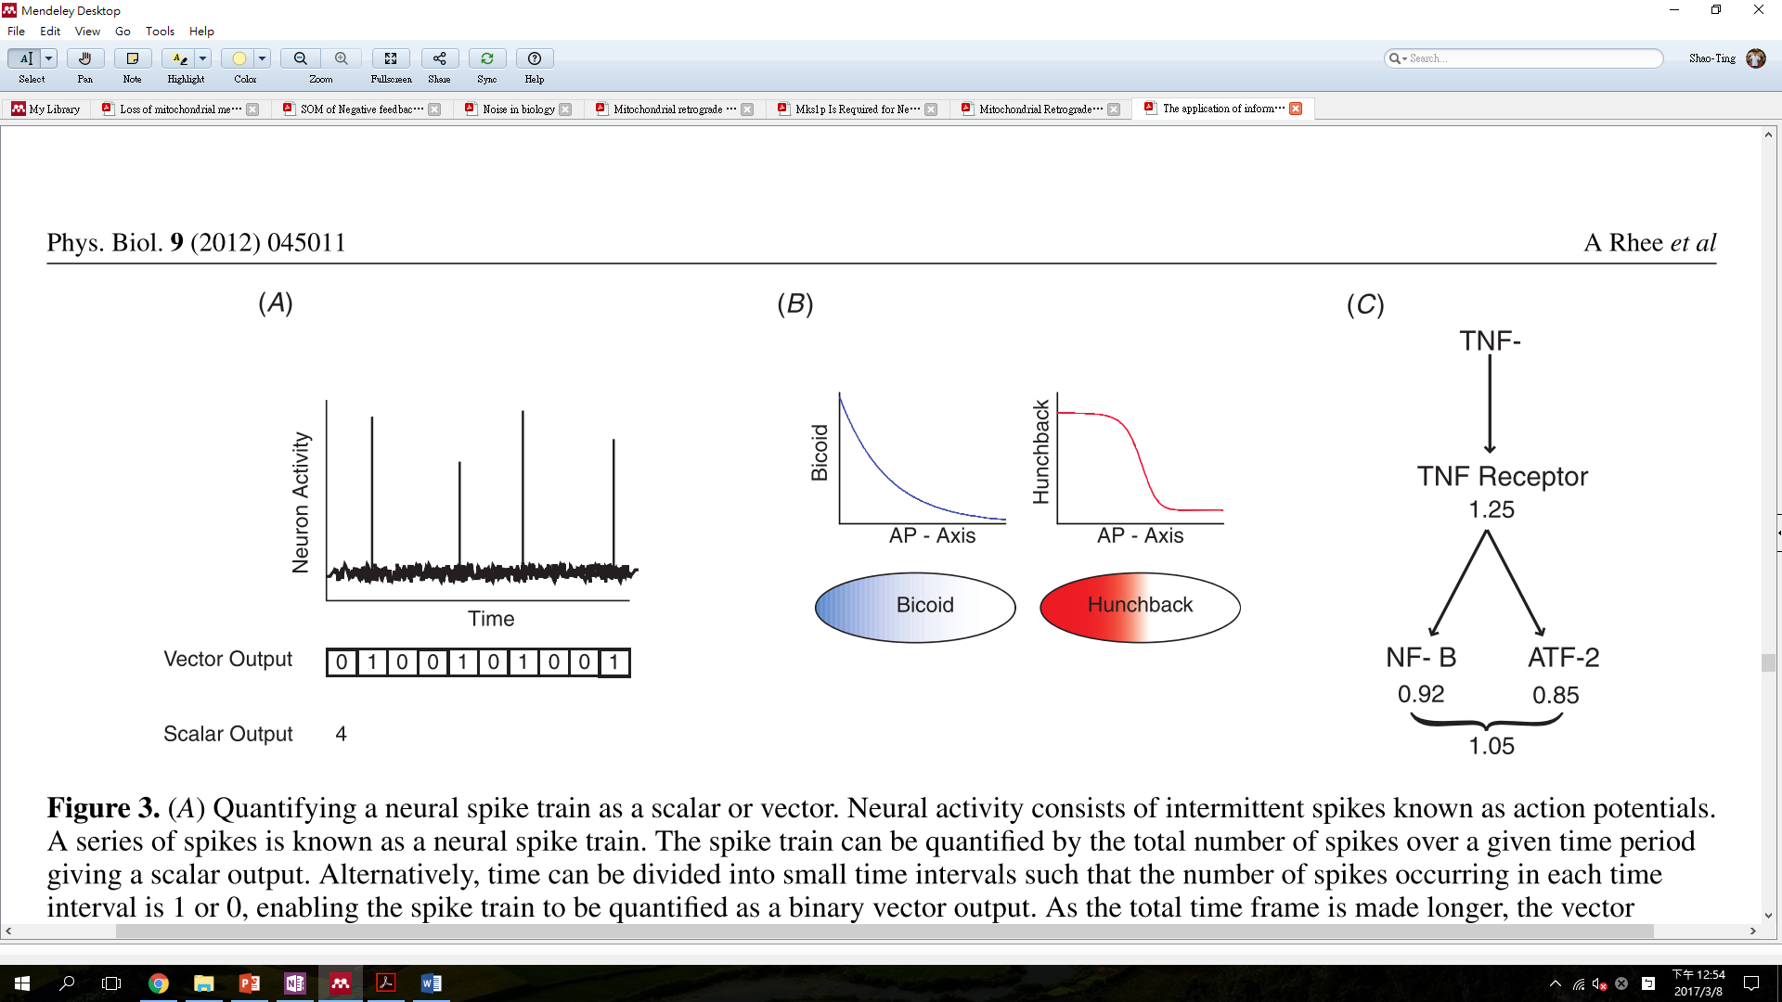
A workflow of measurement of channel capacity
R. Cheong et al.

Slide 22
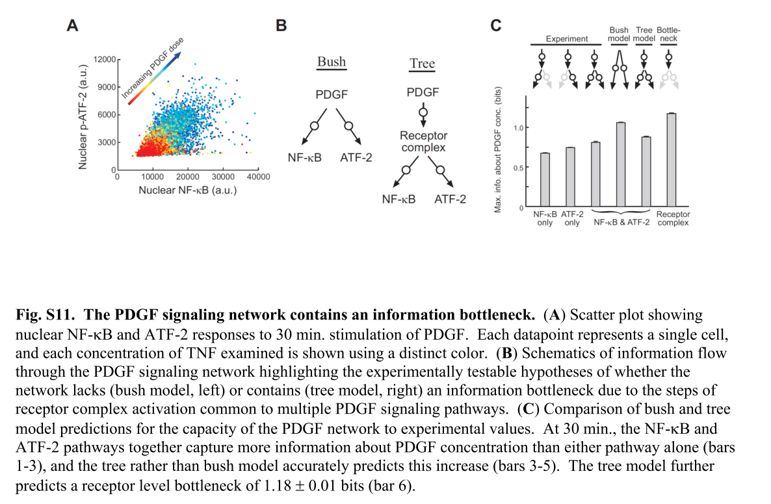
Signaling networks
Prediction of channel capacity based on bush and tree model
R. Cheong et al.

Slide 23
Discussion
Is MMP homogeneous among the mitochondrial population?
Confocal image
How to quantitatively measure MMP and retrograde responses in single-level and time-series
PMPI, TMRM, RTG3p-BFP, mitotracker, H2B-BFP
What is the biological meaning of the channel capacity of mitochondrial retrograde response
Does achieving the channel capacity benefit the cell?
How does the biochemical network contribute to the channel properties?
Are there predictive properties in retrograde response?

Slide 24
References
R.Cheong, A.Rhee, C.Joanne Wang, I.Nemenman, and A.Levchenko, “Information Transduction Capacity of Noisy Biochemical Signaling Networks,” 2011.
This is the main paper.
M.V.Miceli, J. C.Jiang, A.Tiwari, J. F.Rodriguez-Quiñones, and S. M.Jazwinski, “Loss of mitochondrial membrane potential triggers the retrograde response extending yeast replicative lifespan,” Front. Genet., vol. 2, no. JAN, pp. 1–11, 2012.
Z. Liu and R. A Butow, “Mitochondrial retrograde signaling.,” Annu. Rev. Genet., vol. 40, pp. 159–185, 2006.
A. a Gerencser et al., “Quantitative measurement of mitochondrial membrane potential in cultured cells: calcium-induced de- and hyperpolarization of neuronal mitochondria.,” J. Physiol., vol. 590, pp. 2845–71, 2012.
This methodology is what I plan to use in my project, while it uses confocal instead of cytometry.
H.Rottenberg andS.Wu, “Quantitative assay by flow cytometry of the mitochondrial membrane potential in intact cells.,” Biochim. Biophys. Acta, vol. 1404, pp. 393–404, 1998.
Another way to measure MMP.
A.Egner, S.Jakobs, andS. W.Hell, “Fast 100-nm resolution three-dimensional microscope reveals structural plasticity of mitochondria in live yeast.,” Proc. Natl. Acad. Sci. U. S. A., vol. 99, no. 6, pp. 3370–5, 2002.

